Slide 1
MATLAB Programming
Final Exam Two
Instructor: 黃世強 (Sai-Keung Wong)

Slide 2
Content
There are two problems. You must answer all of them.
You can create new files for functions.

Slide 3
About demo video and demo programs.
A demo video or a demo program may have bugs. They show or illustrate roughly the results. These results may not be exactly the same as the requirements. They are for your own reference. You must follow the instruction to finish your programs.

Slide 4
Program file name format
Write all your programs in a folder. The folder name is mat_exam_02_student_ID. For example, if your ID is 12345678, the folder name is mat_exam_02_12345678.
Zip the folder and upload it.
Write a program for each problem in one file.
The file name is ex02_X_yourStudentID.m, where X is the problem number.
For example, if your student ID is 12345678 and the problem number is 3, then the file name must be ex02_3_12345678.m.
You must not output all the intermediate results.
Output the results that are required only.

Slide 5
File content header
At the top of the file, write down your name, ID, email address, department, and date. If you do not do so, you receive a score of zero in the corresponding problem.
%%%%%%%%%%%%%%%%%%%%%%%%%%%
% Final Exam Number: …
% Problem number: …
% Student Name: …
% Student ID: …
% Email address: …
% Department:
% Date: ….
%%%%%%%%%%%%%%%%%%%%%%%%%%%%

Slide 6
File content
For each problem, display the problem number before showing the results.
close all; clear; clc; % close all windows
% clear variables, and clear screen
disp('Exam Problem 2.1') % show Exam Problem 2.1

Slide 7
(50%) Problem 2.1
Assume that Y is generated randomly in a uniform manner inside (0,1).
Let X = F(Y) = b sin(π/2 a Y ²).
Ask to input a, and b. Assume that each of them is nonzero. The valid input is that
a in [0.1, 1], and
b in [-1, -0.1] or [0.1, 1].
Ask to input the number of samples of X. Let the number be n. Implement the following steps:
If n is zero, quit the program. n is inside [0, 2000000].
Ask to input a and b. Check if they are valid. If they are invalid, show a message and repeat step 2.
Ask to input an option:
Option 1) Show pdf of x for given a and b
Option 2) Show pdf of x for fixed sets of a and b

Slide 8
Problem 2.1. Option 1. [30%]
Clear the figure(s). Use a 1x2 grid to draw figures.
Randomly generate n samples of X.
Draw the pdf of Y on a subfigure on the left. Then draw the pdf of X on a subfigure on the right.
Report the average (M) and standard deviation (SD) of the n samples as the title of the figure. Also, report a, and b. The format is: Mean= …; SD= …; a=…; b=…;
Animate a point to move along the curve of the pdf of Y. Also, animate the corresponding point on the curve of the pdf of X.
Note the movement direction of the point depends on the sign of b.

Slide 9
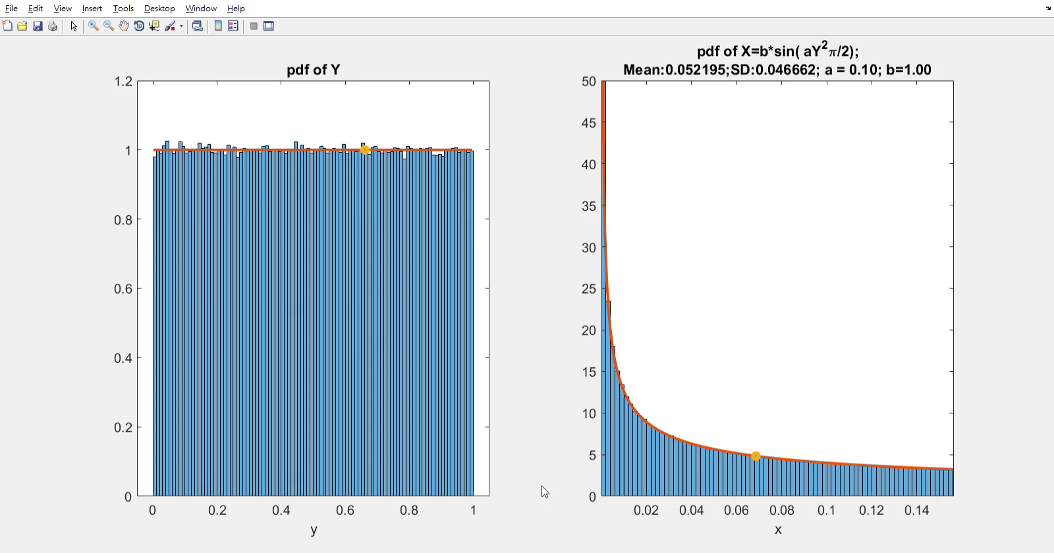
Problem 2.1. Option 1. a =0.1. b =1.0.

Slide 10
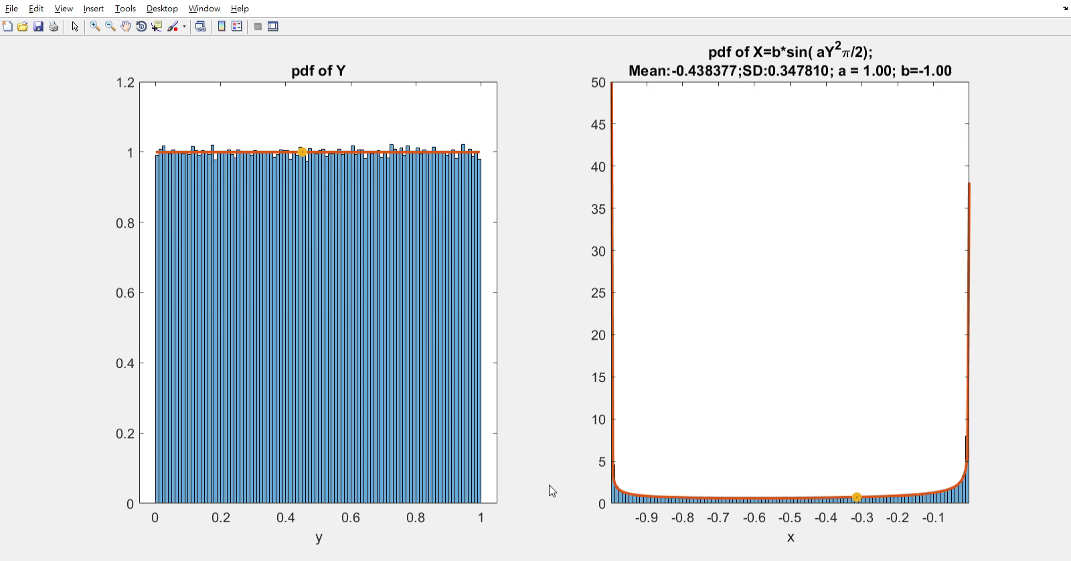
Problem 2.1. Option 1. a =1. b =-1.

Slide 11
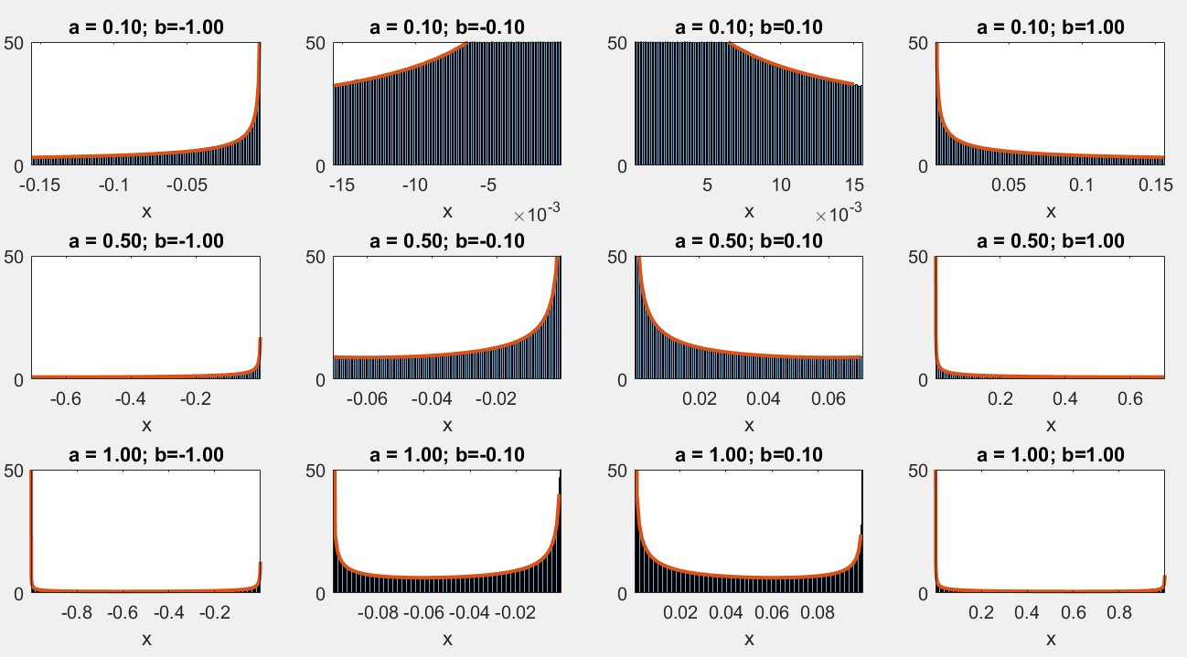
Problem 2.1. Option 2. [20%]
Show the pdf of X in a 3x4 grid. Show the values of a and b as titles. The values of a are 0.1, 0.5 and 1.0 from top to bottom. The values of b are -1.0, -0.1, 0.1, and 1.0 from left to right.

Slide 12
Problem 2.1. Option 2.

Slide 13
Problem 2.1. Marking Scheme
The items must be done correctly.
Option 1.
[1%] Draw the pdf curve of Y.
[4%] Draw the histogram in pdf of Y.
[5%] Draw the pdf curve of X.
[5%] Draw the histogram in pdf of X.
[5%] The animation of the point on the pdf curve of Y.
[5%] The animation of the point on the pdf curve of X.
[5%] The animation is repeated.
[5%] The titles of both figures.
Option 2.
[5%] There are 3x4 figures and they are correct.
[5%] The titles of the figures.
[5%] The arrangements of the figures based on a and b.

Slide 14
(50%) Problem 2.2.
There are two options.
Show student ID and name.
Then show a message to ask for option.
Option 1) Function Graph
Option 2) Fractal
Enter the option:

Slide 15
Problem 2.2. Option 1.
The following diagrams show how the inputs are computed to produce new values. Note that if the inputs are vectors, operations are performed in the array format.
h
a
x
g
x
x
g
g(x)
k
g
g(x,y)
b
y
y
A function accepts one parameter, x. It produces a new value g(x).
A function accepts two parameters, x and y. It produces a new value g(x,y).
This diagram performs:
a = h(g(x)), and b = k(g(x), y).

Slide 16
Problem 2.2. Option 1.
Write a program to implement the following diagrams:
g₂₁
g₃₁
x
g₁₁
g₄₁
x
g₂₂
g₃₂
g₅₁
z
y
g₁₂
g₂₃
g₃₃
y
g₄₂
g₂₄
g₃₄

Slide 17
Problem 2.2. Option 1.
Assume that the inputs are a and b. The functions are defined as follows.
Layer1 | Layer 2 | Layer 3 | Layer 4 | Layer 5
g₁₁(a,b) = a+b | g₂₁(a,b) = sin(a)./(cos²(b)+1) | g₃₁(a,b) = e^{-(a+b).*(a+b)} | g₄₁(a,b) = cos(a) + sin(b) | g₅₁(a,b) = b .* sin(a)
g₁₂(a,b) = a-b | g₂₂(a,b) = a.*b | g₃₂(a,b) = a – b | g₄₂(a,b) = cos (b) + sin(a)
 | g₂₃(a,b) = a + b | g₃₃(a,b) = sin(a) + cos(b)
 | g₂₄(a,b) = b - a | g₃₄(a,b) = cos(b) ./ (|a| + 1)

Slide 18
Problem 2.2. Option 1.
Set x in [-1.5, 1.5] and y in [-1.5, 1.5]. The step size is 0.05.
Plot the mesh of z. Label the x-axis and the y-axis.
Hint:
Use meshz(X, Y, Z);
X and Y are produced by meshgrid.
Z contains the values for all the combinations of x and y in the grid of X and Y.

Slide 19
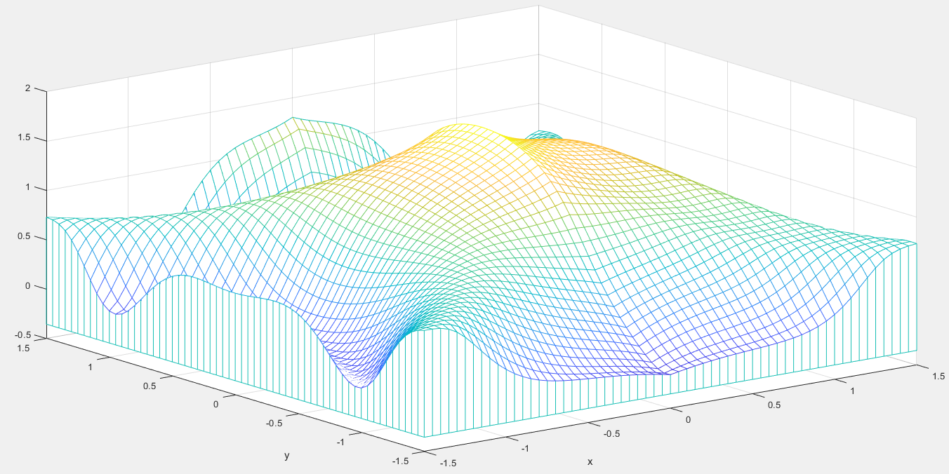
Problem 2.2. Option 1. Notice that the labels of the x-axis and y-axis shows the ranges that are the same as what we set for x and y.

Slide 20
Problem 2.2. Option 2.
Call julia to create a fractal image.
arg1 = 120; arg2 = 350;
Save the julia image.
Load tmp.png and combine the julia image to produce a new image. Please see the demo image.

Slide 21
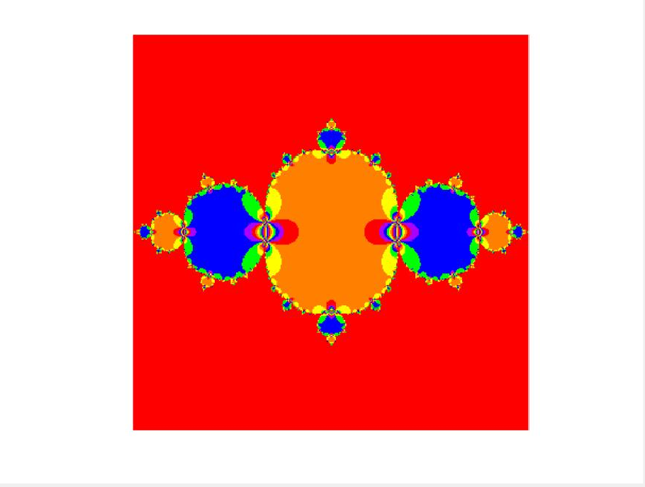
Problem 2.2. Option 2. The julia image.

Slide 22
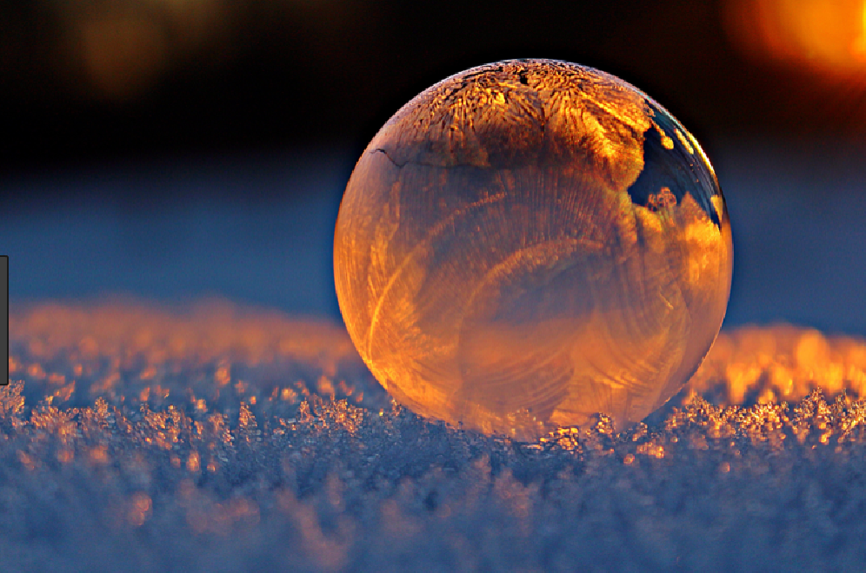
Problem 2.2. Option 2. The tmp.png image

Slide 23
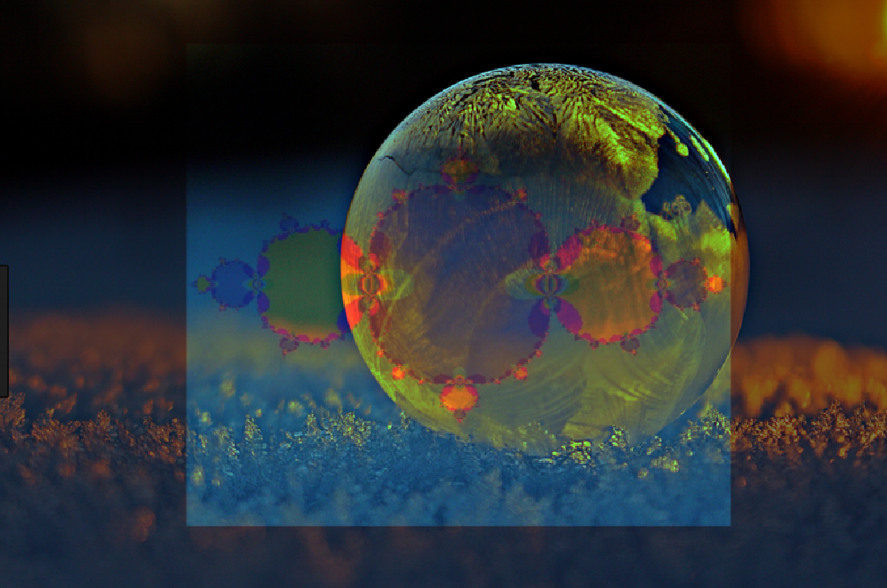
Problem 2.2. Option 2. The demo image of the result. The image of tmp.png must not be distorted. The julia image must be large, covering at least 50% of the image of tmp.png.

Slide 24
Problem 2.2. Marking scheme
Option 1.
[30%] The mesh is correct.
Option 2.
[5%] The Julia image is correct.
[15%] The result image is similar to the demo image. The image of tmp.png must not be distorted. The julia image must be large, covering at least 50% of the image of tmp.png.

Slide 25
Hint
K1 = 1-0.5.*K; %guess the meaning. Here, K is the julia image in RGB.

Slide 26
End
Enjoy MATLAB Programming.

